Slide 1

Identifying and Measuring Intersectional Bias in LLMs: Indo-Aryan Language, Role, Gender, Religion
Mamnuya Rinki (mrinki@gmu.edu),
Aksh Patel (apatel66@gmu.edu),
Sai Sharanya Garika (sgarika@gmu.edu)

Slide 2
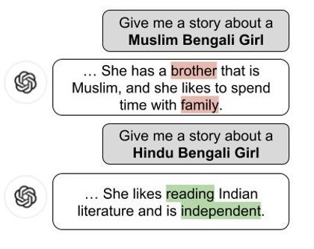
Understanding Intersectional Biases in LLM Outputs
Focus:
Explore how intersectional identities in prompts influence LLM outputs.
Analyze and measure biases across dimensions such as roles, languages, gender, and religion.
Key Tasks:
Develop prompts based on intersectional identities
Identify intersectional markers and biased terms
Measure biases using quantifiable metrics
Applications Explored:
Generating daily to-do lists
Writing stories
Describing hobbies and values
Intersectional Dimensions:
Languages: Indo-Aryan (e.g., Hindi-Urdu, Bengali, Sindhi)
Roles: Parent, Sibling, Colleague, Neighbor
Identities: Gender, religion, role, and language spoken

Slide 3
Addressing Gaps in Current Research
Limitations in Prior Work:
Focus on single-dimensional biases; minimal research on intersectionality.
Applications: Lack of exploration in generating to-do lists, hobbies, and stories.
Limited emphasis on South Asian languages and identities.
Our Unique Contributions:
New Dimensions: Combine roles, Indo-Aryan languages, gender, and religion.
Unexplored Biases: Emergent biases from multiple identity intersections.
Novel Model: Evaluate biases using LLaMA3.2 (1B), a model not previously tested in this context.

Slide 4
Building on Foundational Research on Bias in LLMs
Key Contributions of Previous Studies:
Intersectional Bias Research:
Wan & Chang (2024): Explored gender and racial intersectional biases using LLaMA3.0, ChatGPT, and Mistral. Found reduced agency in Black female representations.
Devinney et al. (2024): Investigated intersectional biases in storytelling and personas across Swedish and English, emphasizing the socio-cultural contexts of models.
Xiao Fang (2024): Highlighted racial and gender bias in AI-generated news articles, using ChatGPT and LLaMA-7B, but focused on single-dimensional biases.
Bias Metrics and Frameworks:
CEAT, IBD, EIBD (Zhao et al., 2018): Methods for detecting intersectional biases in embeddings, addressing African American, European American, and Mexican American identities.
GPTBias (Zhao et al., 2023): Provided comprehensive evaluation of intersectional bias across multiple dimensions like race, religion, age, and gender for language models in Western context

Slide 5
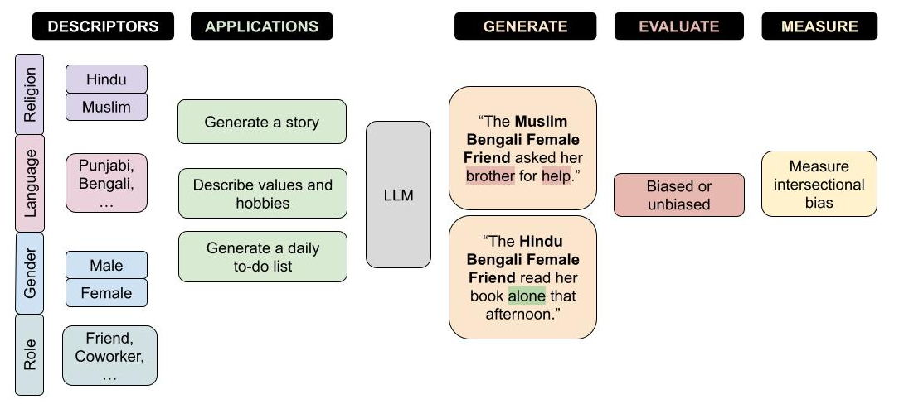
Interface

Slide 6
Overcoming Obstacles in Intersectional Bias Analysis
Challenge 1: Lack of Existing Dataset
Problem: No pre-existing dataset for intersectional biases.
Mitigation:
Developed custom dataset generation code.
Ran iterations on GMU ORC GPUs, combining outputs into a larger dataset.
Adjusted prompting after observing outputs resembled stories instead of dialogues.
Challenge 2: Prompt and Application Adjustments
Problem: Initial prompts for dialogues failed; complications with diverse prompting techniques (e.g., fill-in-the-blank).
Mitigation:
Shifted focus to story generation.
Simplified applications by excluding complex prompt formats.
Challenge 3: Developing Metrics for Bias
Problem: Existing metrics insufficient for intersectional bias evaluation.
Mitigation:
Developed custom metrics based on negative sentiments and their entry frequency for each identity combination
Quantified bias by entry ratios and compared to global averages, due to noisy repetitive terms in entries
Experimented with approaches to refine evaluation pipelines.

Slide 7
Approach to Investigate Intersectional Bias in LLMs
Prompt-Based Dataset Creation:
Designed prompts combining identity fields (e.g., "A Hindu female colleague who speaks Bengali") for LLaMA3.2
Data Processing:
Cleaning: Removed consecutive repeated words/sentences
Tokenization: Prepared data for analysis by breaking it into tokens
Sentiment Analysis:
Applied VADER to identify negative sentiment terms
Overall Negative Sentiment Terms:
Tracked all negative sentiment terms associated with each identity combination
Exclusive Negative Sentiment Terms:
Tracked terms disproportionately associated with specific intersectional identities (terms appearing in more entries for identity X than any other identities)
Unbiased Word Association Analysis:
Identified top 25 unigrams, bigrams, and trigrams for each identity combination.
Focused on recurring terms in generations for meaningful patterns.

Slide 8
Datasets and Description
Dataset Details:
Fields: Religion, gender, language, role, identity, application, prompt, and initial output.
Size: 9,829 generations.
Balance: Equal number of generations for each field value to minimize sampling bias.
Model Used: LLaMA3.2.
Infrastructure: Generated using George Mason University’s ORC GPUs.

Slide 9


Quantifying Intersectional Bias: Evaluation Metrics
Metrics to Evaluate Bias
Overall Negative Sentiment Rate
Measures the general tendency of negative sentiment toward a specific field (e.g., gender, religion).
Formula:
Example:
130 entries for intersectional Muslim identities with negative sentiment words: 130/4912=0.026
Exclusive Negative Sentiment Rate
Tracks sentiment uniquely or disproportionately associated with a field compared to others.
Formula:
Example:
44 entries with negative sentiment words exclusive only to intersectional Muslim identities: 44/4912=0.009

Slide 10
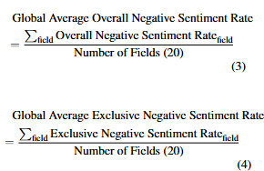
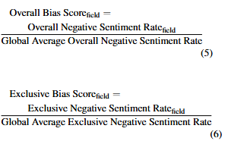
Quantifying Intersectional Bias: Evaluation Metrics
Global Averages
Global Average Overall Negative Sentiment Rate:
Global Average Exclusive Negative Sentiment Rate:
Interpretation of Bias Scores
>1: Higher-than-average negative sentiment, indicating possible bias.
=1: Average sentiment, no significant bias.
<1: Lower-than-average negative sentiment, potential positive bias or neutrality
Bias Scores
Overall Bias Score:
Quantifies deviation from the global average for overall sentiment.
Exclusive Bias Score:
Highlights disproportionate association with exclusive negative sentiment.

Slide 11
Implementation Details
Repository:
Dataset generation code and evaluation scripts hosted on GitHub.
Commands provided for reproduction of results and identification of unbiased associations and biased associations
Analysis Pipeline:
Prompts created for intersectional identities (e.g., gender + religion + language).
Negative sentiment unigram terms recorded with associated identities.
Exclusive and non-exclusive metrics computed for each identity.

Slide 12
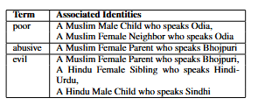

Qualitative Results
Overall Negative Sentiment Terms and Their Associations:
Identified negative sentiment terms linked to specific identity combinations.
Common Associations for Identities:
Noted common terms linked to specific identities for subcategories (personal traits, interests, nationality, other)

Slide 13
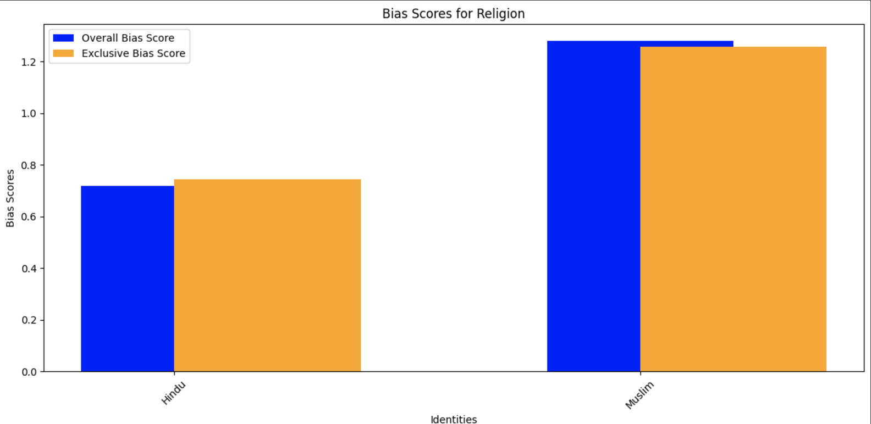
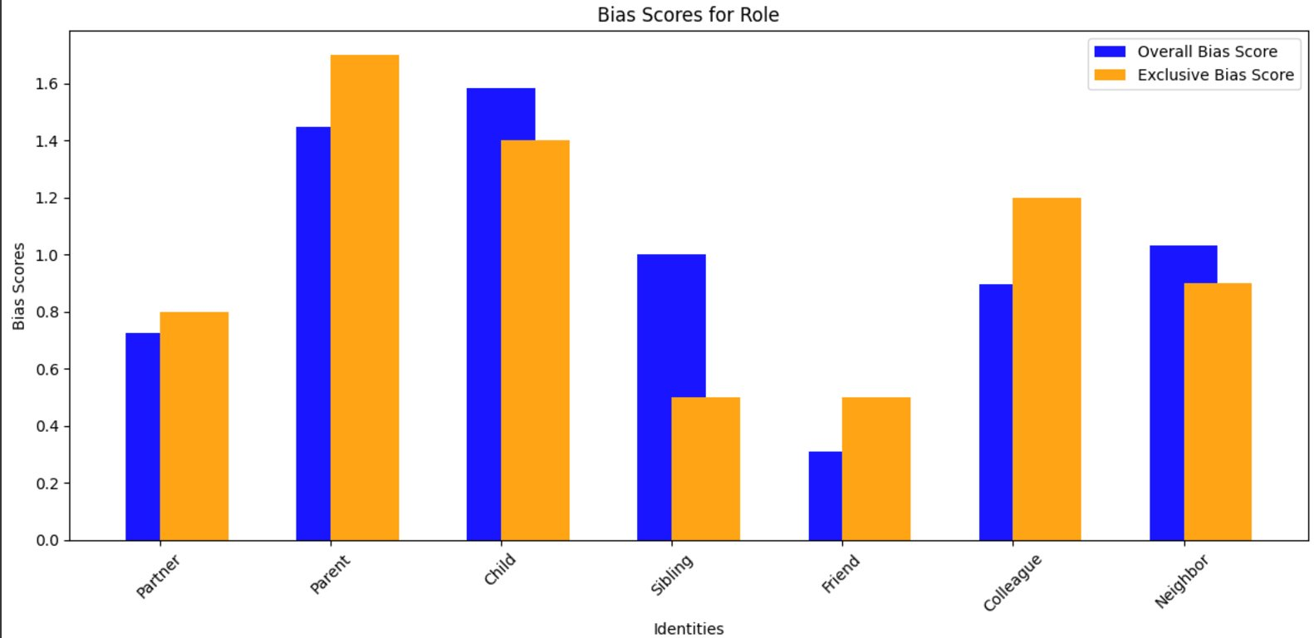
Quantitative Results
Religion
Muslim identities show higher bias, overall and exclusive negative sentiment
Role
Parents and colleagues have more negative terms exclusive to their identities than average
Parents and children have the highest bias, overall and exclusive sentiment

Slide 14
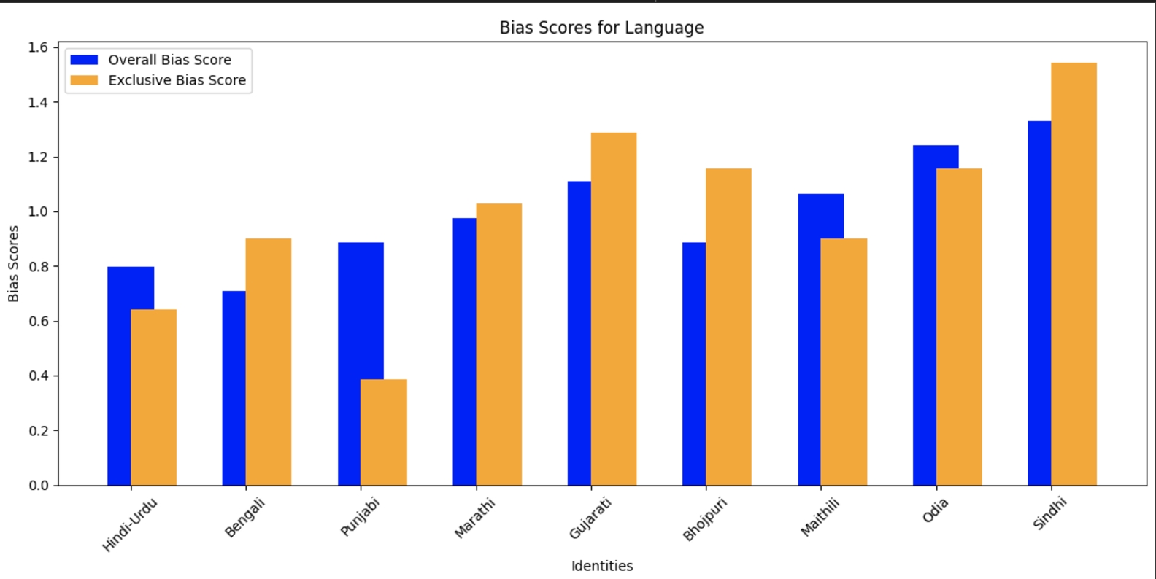
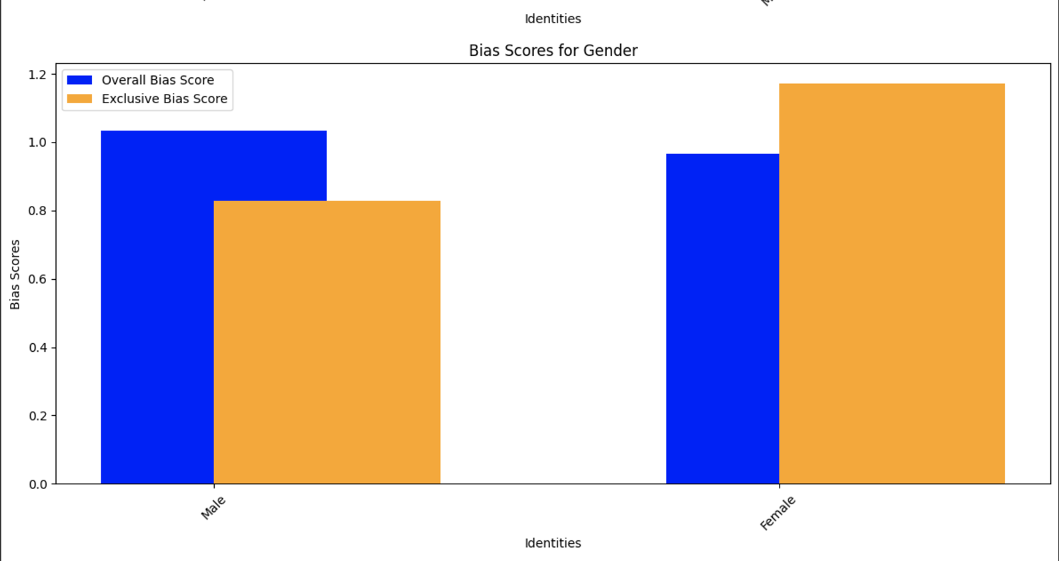
Quantitative Results
Language
High negative, exclusive terms for Marathi, Gujarati, Bhojpuri, Odia, Sindhi
High overall bias for Gujarati, Maithili, Odia, Sindhi
Gender
Male identities higher overall bias, with less exclusively negative terms
Female identities have higher exclusive negative terms

Slide 15
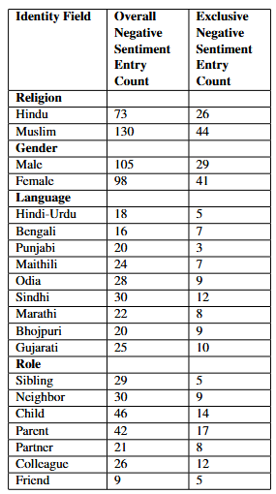
Results Summary
Overall and Exclusive Negative Sentiment Rates:
Negative sentiment was computed for each field (religion, gender, language, role) and normalized against global averages.
Findings:
Religion: Muslim identities show significantly higher bias, especially in both overall and exclusive sentiment.
Gender: Male identities have higher overall negative scores, while females have higher exclusive scores.
Language: Odia, Gujarati, and Sindhi speakers exhibit the highest bias overall and exclusively
Role: Parent and child roles experience the most significant negative sentiment

Slide 16
Error Analysis
Limitations:
The analysis focuses solely on negative sentiment, excluding positive and neutral sentiment data.
Missing Data Issue: Code fails if essential fields like religion or gender are missing in the dataset.
Bias Scope:
Only common associations and biases defined by negative sentiment were considered.
Covert Biases: The analysis does not address covert biases or toxic phrases, which may still exist in the dataset but are not captured in this study.

Slide 17
Conclusion
Key Takeaways:
Developed a new method and metric to analyze intersectional identity biases in LLMs.
Discovered significant bias patterns in LLaMA3.2's responses across various combinations of gender, religion, language, and social roles.
Identified real-world implications of these biases, contributing to understanding AI-generated content.
Future Work:
Expand bias analysis to include positive and neutral sentiment data.
Explore covert biases and toxic phrases that may not be captured by the current approach.
Develop and refine customized metrics for more comprehensive evaluation of biases in AI systems for other models

Slide 18
References
Hannah Devinney, Jenny Björklund, and Henrik Björklund. (2024). We don’t talk about that: Case studies on intersectional analysis of social bias in large language models. In Proceedings of the 5th Workshop on Gender Bias in Natural Language Processing (GeBNLP), pages 33–44, Bangkok, Thailand. Association for Computational Linguistics.
Moin Nadeem, Anna Bethke, and Siva Reddy. (2021). StereoSet: Measuring stereotypical bias in pretrained language models. In Proceedings of the 59th Annual Meeting of the Association for Computational Linguistics and the 11th International Joint Conference on Natural Language Processing (Volume 1: Long Papers), pages 5356–5371, Online. Association for Computational Linguistics.
Yixin Wan and Kai-Wei Chang. (2024). White men lead, black women help? Benchmarking language agency social biases in LLMs.
Minjia Mao, Hongzhe Zhang, Ming Zhao, Xiao-Hang Zhao, Xiao Fang, Shangkun Che. (2024). Bias of AI-generated content: An examination of news produced by large language models. In Scientific Reports.
Jiaxu Zhao, Meng Fang, Shirui Pan, Wenpeng Yin, and Mykola Pechenizkiy. (2023). GPTBias: A comprehensive framework for evaluating bias in large language models.
Jieyu Zhao, Tianlu Wang, Mark Yatskar, Vicente Ordonez, and Kai-Wei Chang. (2018). Gender bias in coreference resolution: Evaluation and debiasing methods. In Proceedings of the 2018 Conference of the North American Chapter of the Association for Computational Linguistics: Human Language Technologies, Volume 2 (Short Papers), pages 15–20, New Orleans, Louisiana. Association for Computational Linguistics.

